Slide 1
Data Link Control Protocols

Slide 2
Overview
Flow Control
Effect of propagation delay, speed, frame size
Error Recovery

Slide 3
Flow Control
Flow Control Goals:
1. Sender does not flood the receiver,
2. Maximize throughput
Sender throttled until receiver grants permission

Slide 4
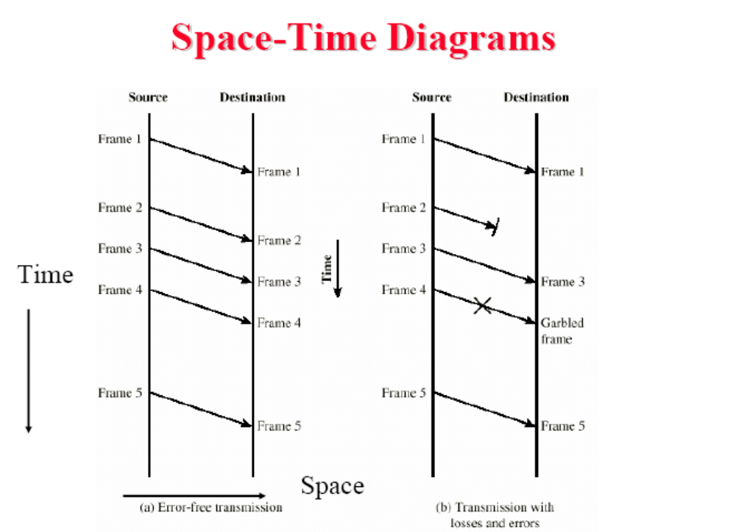

Slide 5
Stop-and and-Wait Flow Control
Source transmits frame
Destination receives frame and replies with
Acknowledgement
Source waits for ACK before sending next
Frame
Destination can stop flow by not send ACK
Works well for a few large frames

Slide 6
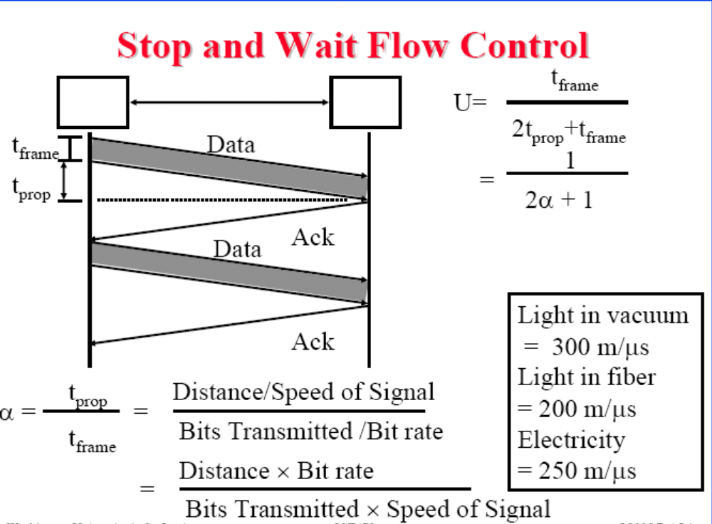

Slide 7
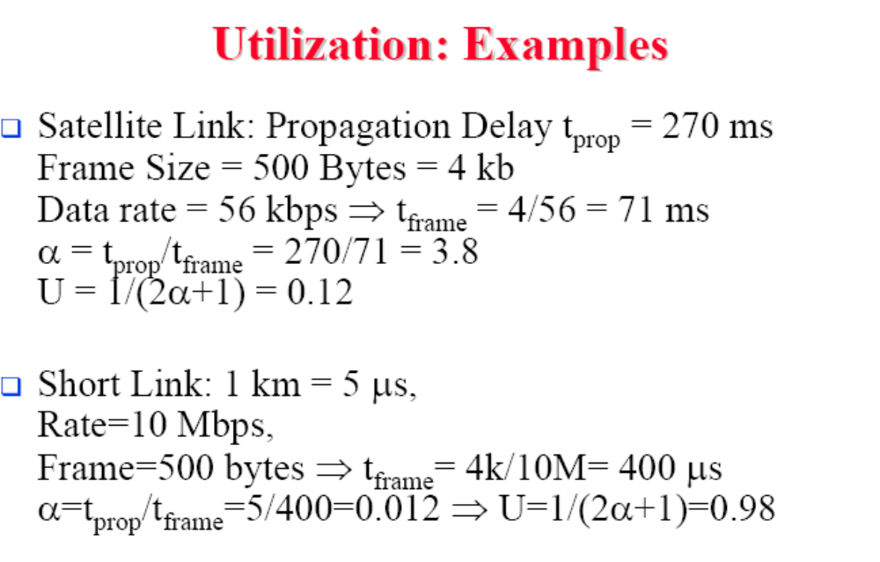

Slide 8
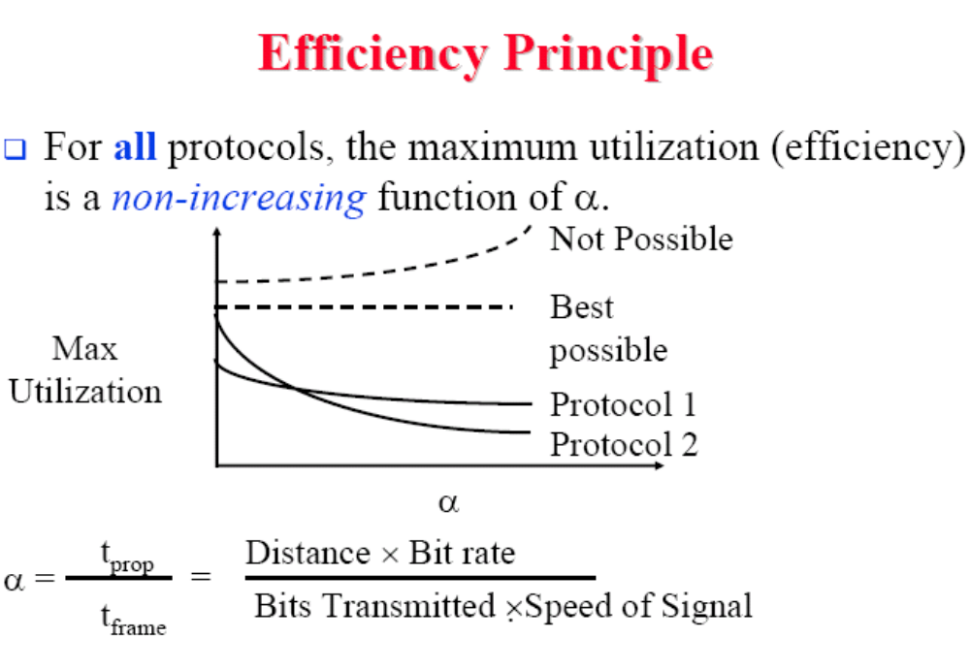

Slide 9
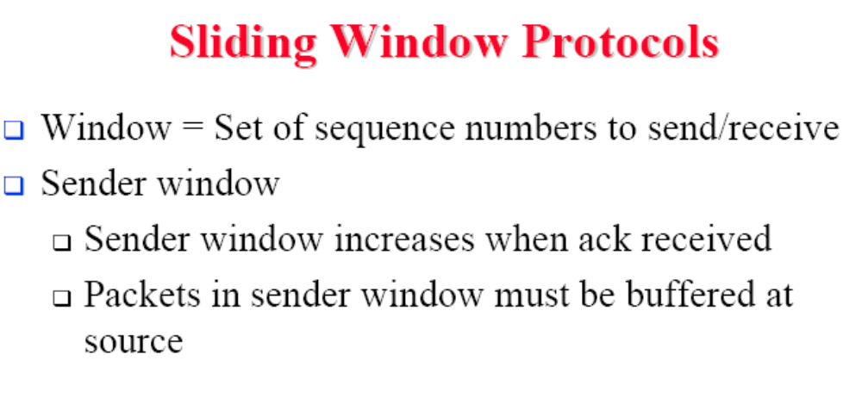

Slide 10
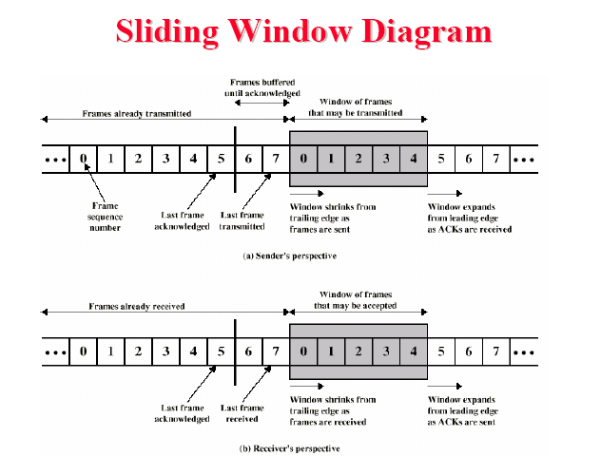

Slide 11
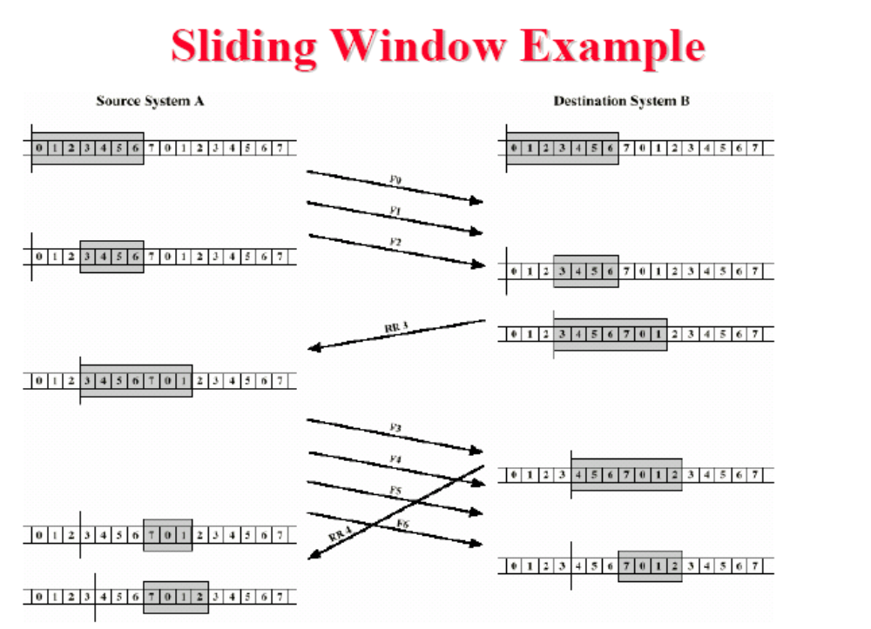

Slide 12
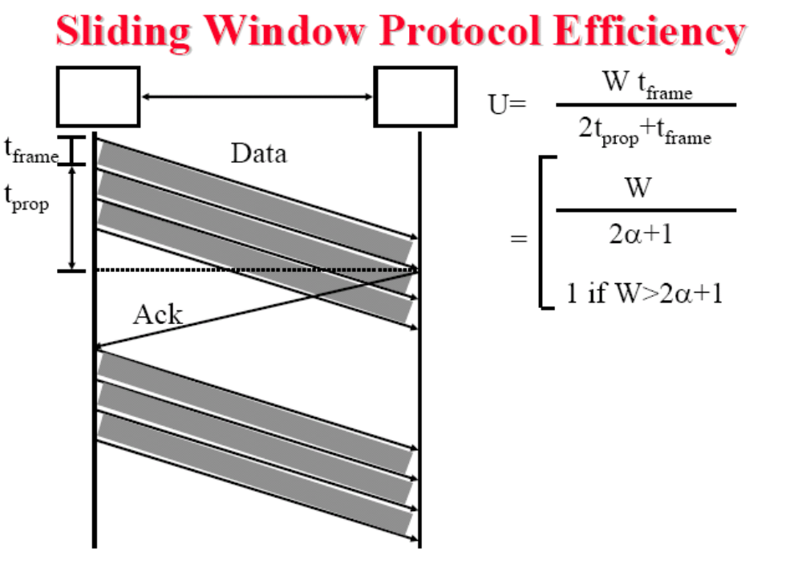

Slide 13
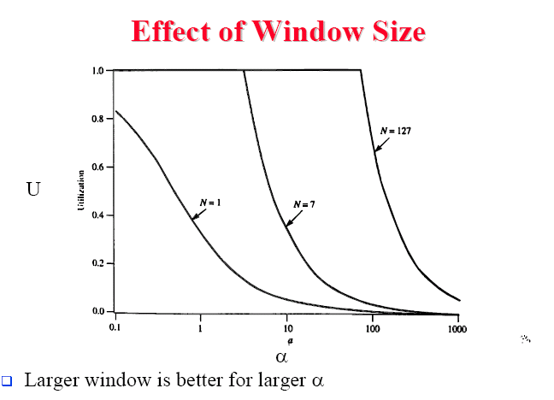

Slide 14
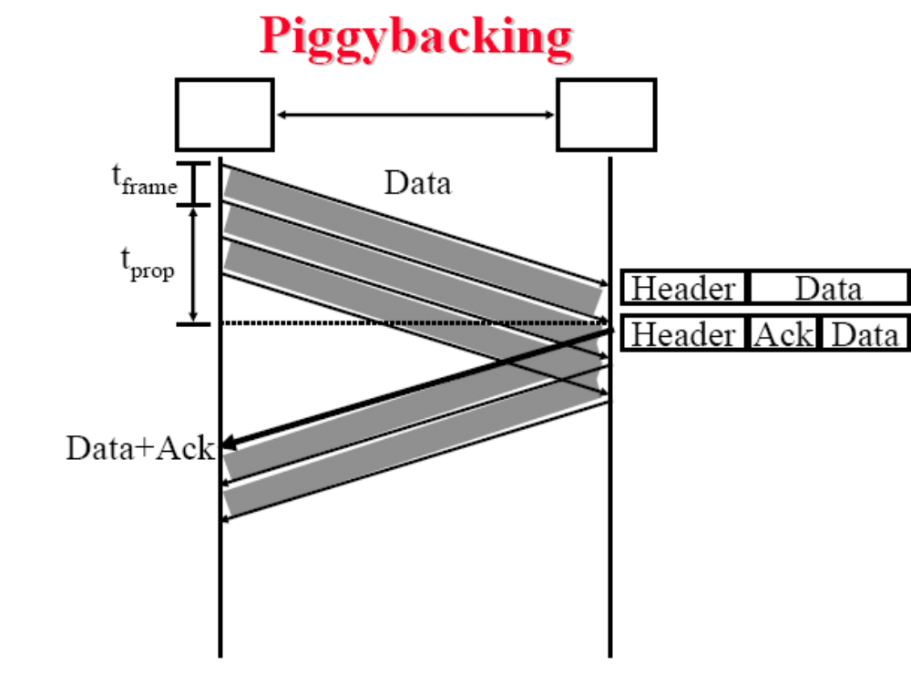
A
B

Slide 15
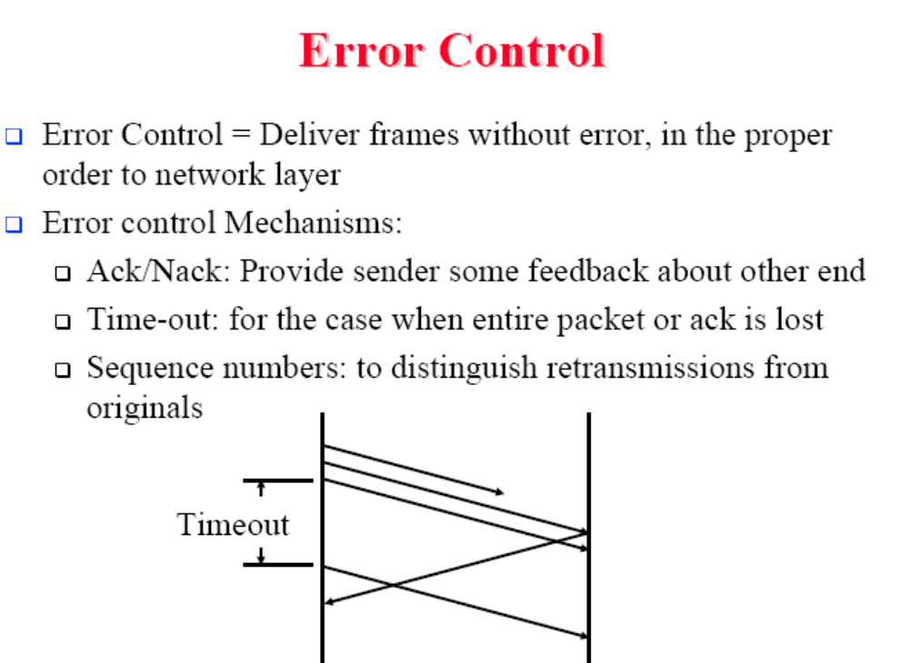

Slide 16
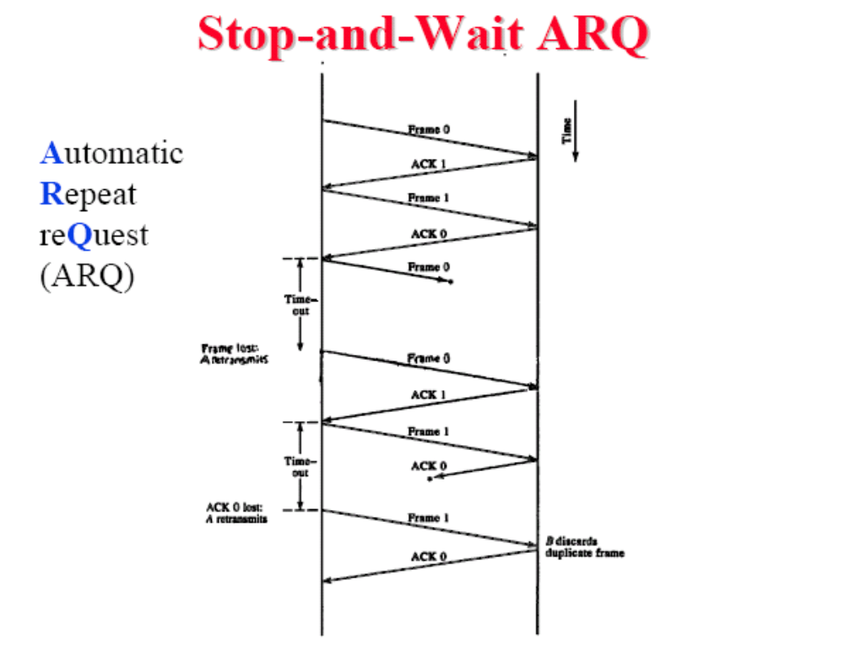

Slide 17
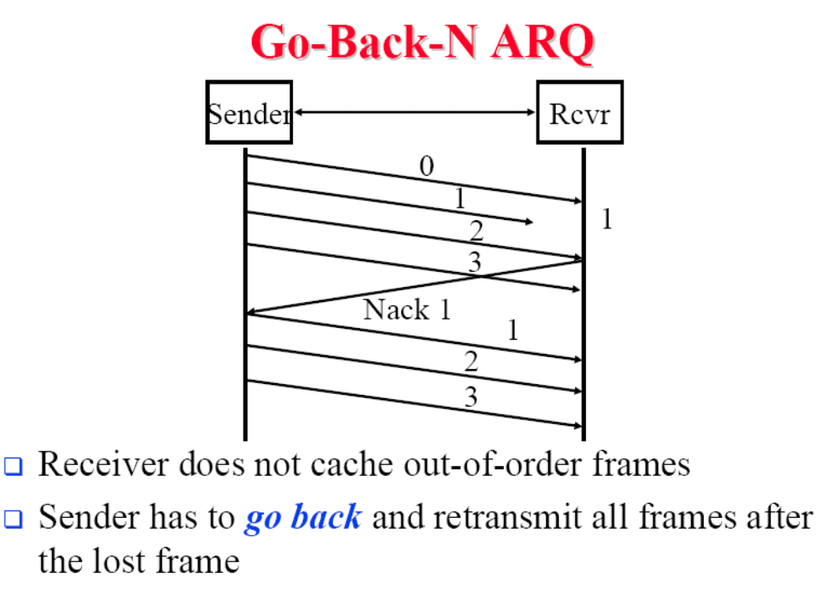

Slide 18
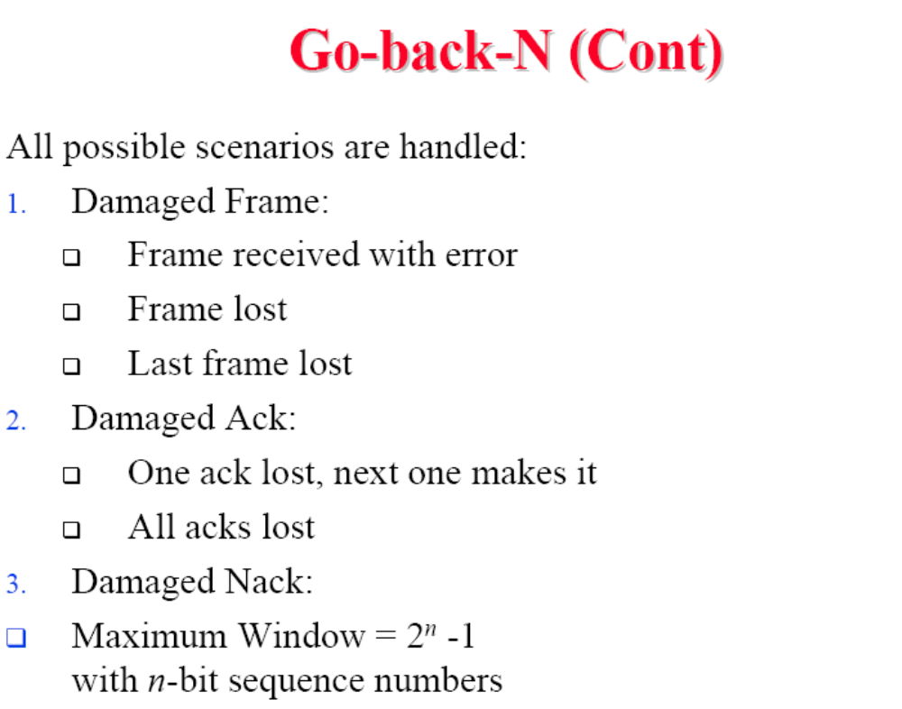

Slide 19
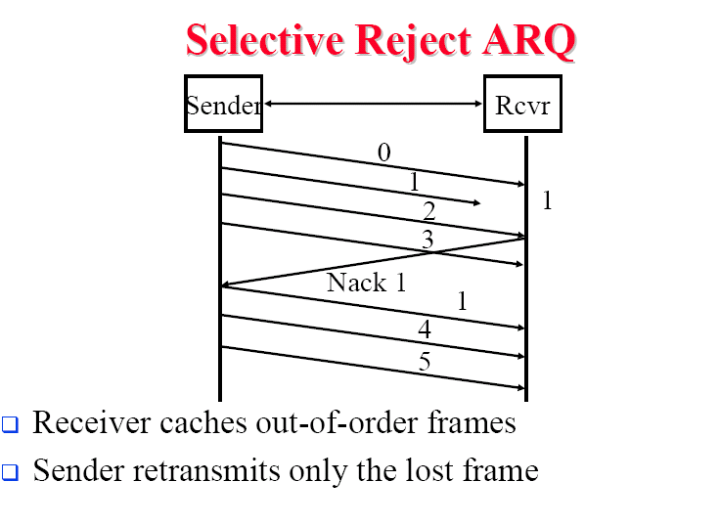

Slide 20
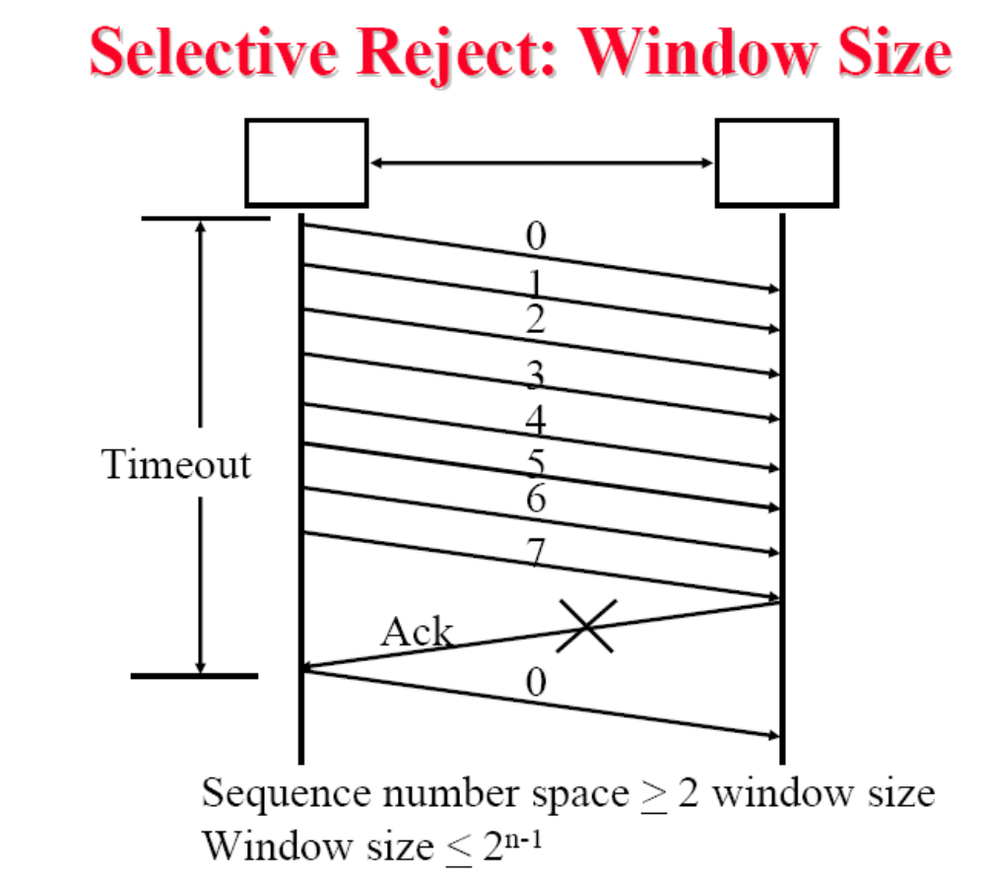

Slide 21
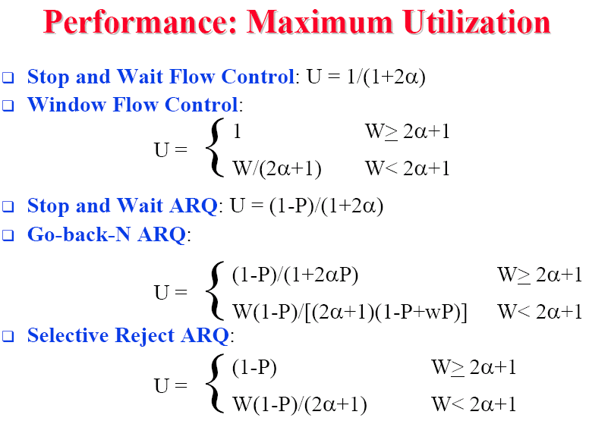

Slide 22
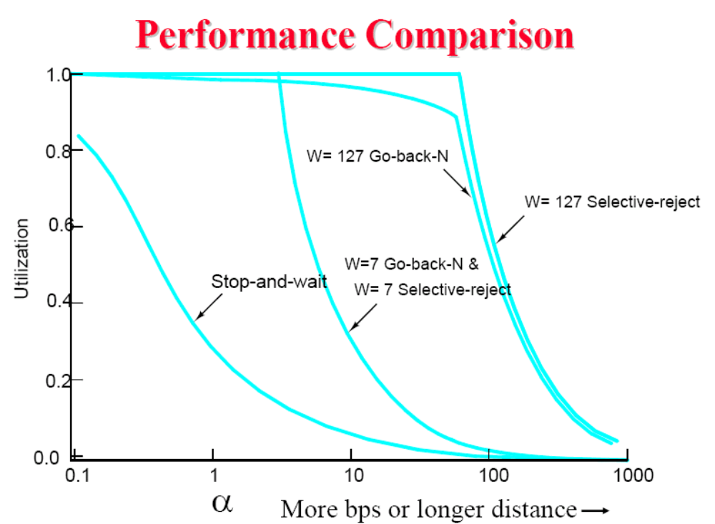

Slide 23
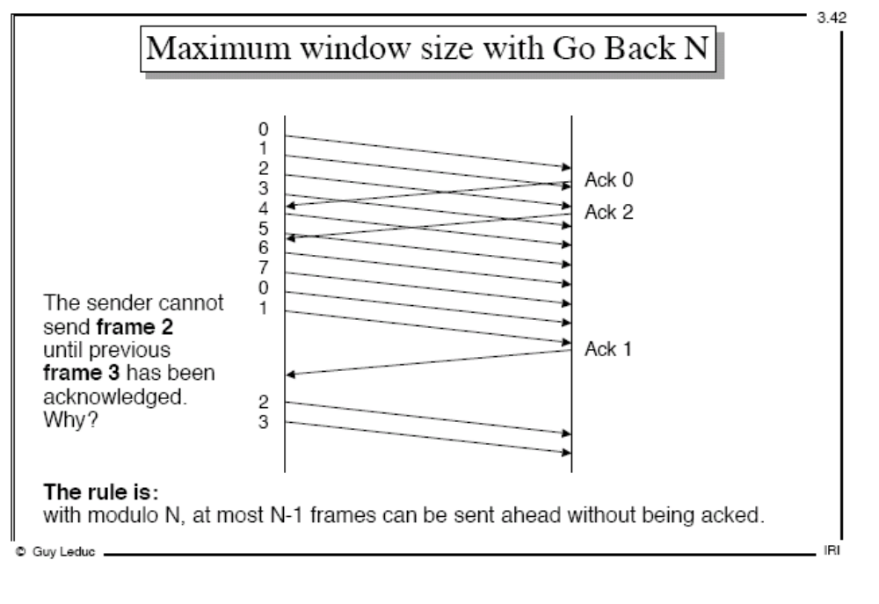

Slide 24
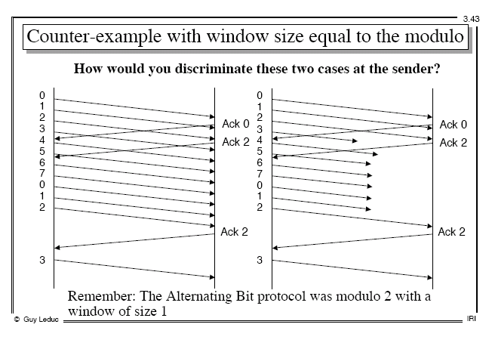

Slide 25
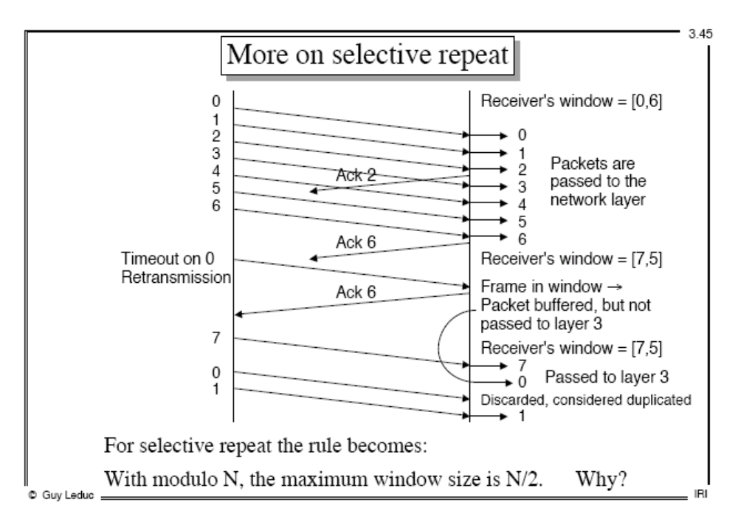

Slide 26
Assignment
Why optical fiber communication is immune to electromagnetic interference?
Consider building a CSMA/CD network at 1 Gbps over a 1 Km cable with no repeaters. What is the minimum frame size? (assume the signal speed in cable is 200,000 km/sec).

